Slide 1

Select Topics in Python Reading from File
Notes:
‹#›

Slide 2

Objectives
Objectives
Introduction file I/O.
Loading a file in Colab.
Reading from a file.
String splitting.
Notes:
‹#›

Slide 3

Introduction File I/O
I/O
Why do we need to use I/O?
Storing data.
Accessing data.
Modifying data.
Notes:
‹#›

Slide 4
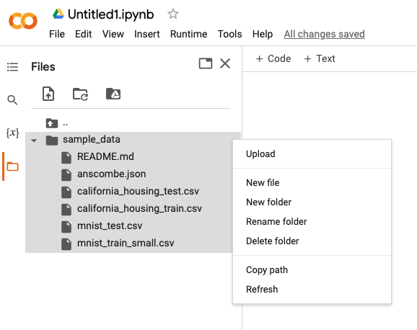
Loading a File in CoLab
Loading file
Select folder.
Open sample_data.
Select three dots.
Upload.
Notes:
‹#›

Slide 5
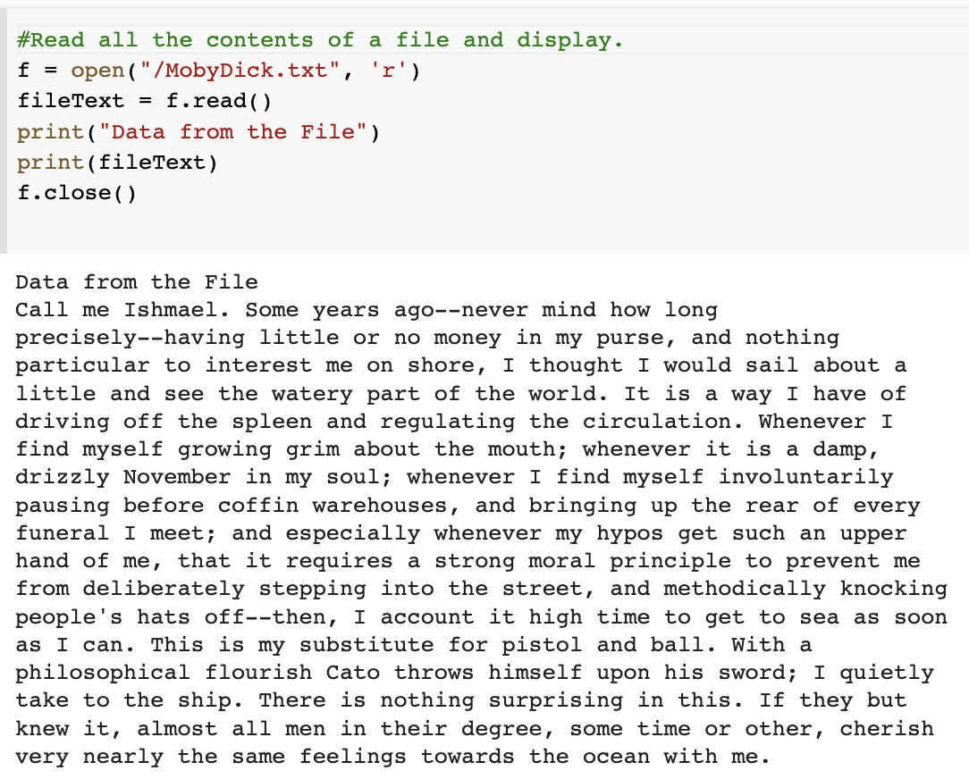
Reading From a File
Read files
Open file.
Read file.
read
readline
readlines
readFile = open(FILE_NAME [, ACCESS_MODE])
Notes:
‹#›

Slide 6
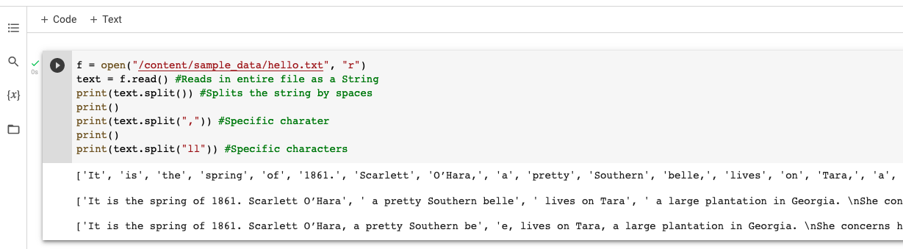
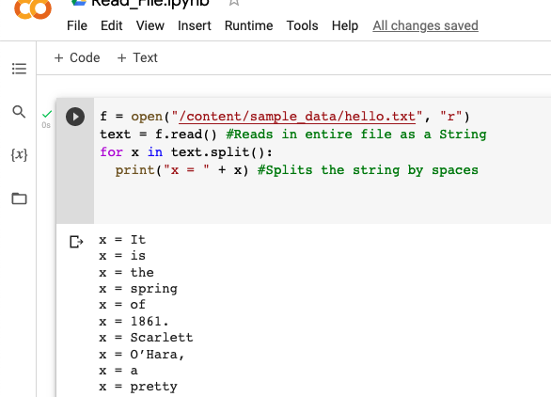
String Splitting
String Splitting
Split default.
Split by character.
Split by characters.
Split using for loop.
Notes:
‹#›

